Slide 1
S
I
L
H
M
V
S
I
L
H
M
V

Slide 2



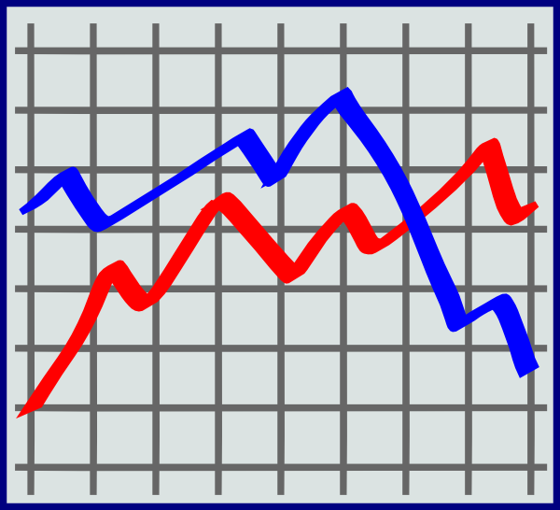




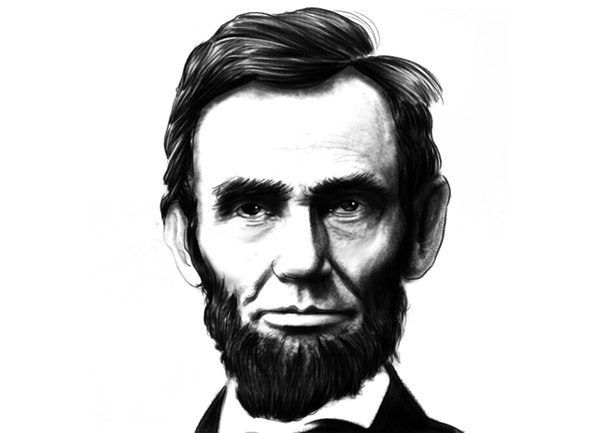
Social Network
Weather
Stocks
Sports
News
Politics
Theme, mood, intent

Slide 3
Social Network
Weather
Stocks
Sports
News
Politics
Aesthetic

Slide 4
Billy Joel’s “Piano Man”
I
V
P
C
V
P
V
P
C
V
P
C
Bruno Mars’ “Uptown Funk”
I
V
P
C
V
P
C
B
B2
C
B
The Eagles’ “Hotel California”
I
V
C
V
C
V
O
Elton John’s “Rocket Man”
I – Intro
V – Verse
P – Pre-chorus
C – Chorus
B – Bridge
O – Outro
V
C
C
V
C
C
O
Phillip Phillips’ “Home”
I
V
P
C
P
C
Notes:
----- Meeting Notes (9/18/15 10:15) -----
Fix color

Slide 5
Sub-Rhyming Schemes
Now looking back over the years,
And whatever else appears
I remember I cried when my father died
Never wishing to hide the tears
And at sixty five years old,
My mother, God rest her soul,
Couldn't understand, why the only man
She had ever loved had been taken
Leaving her to start with a heart
So badly broken
Despite encouragement from me
No words were ever spoken
And when she passed away
I cried and cried all day
Alone again, naturally
Notes:
If you’re just looking at the ends of phrases for rhyming, you’ll miss sub-rhyme schemes that add significant value, novelty, and surprise.

